Slide 1
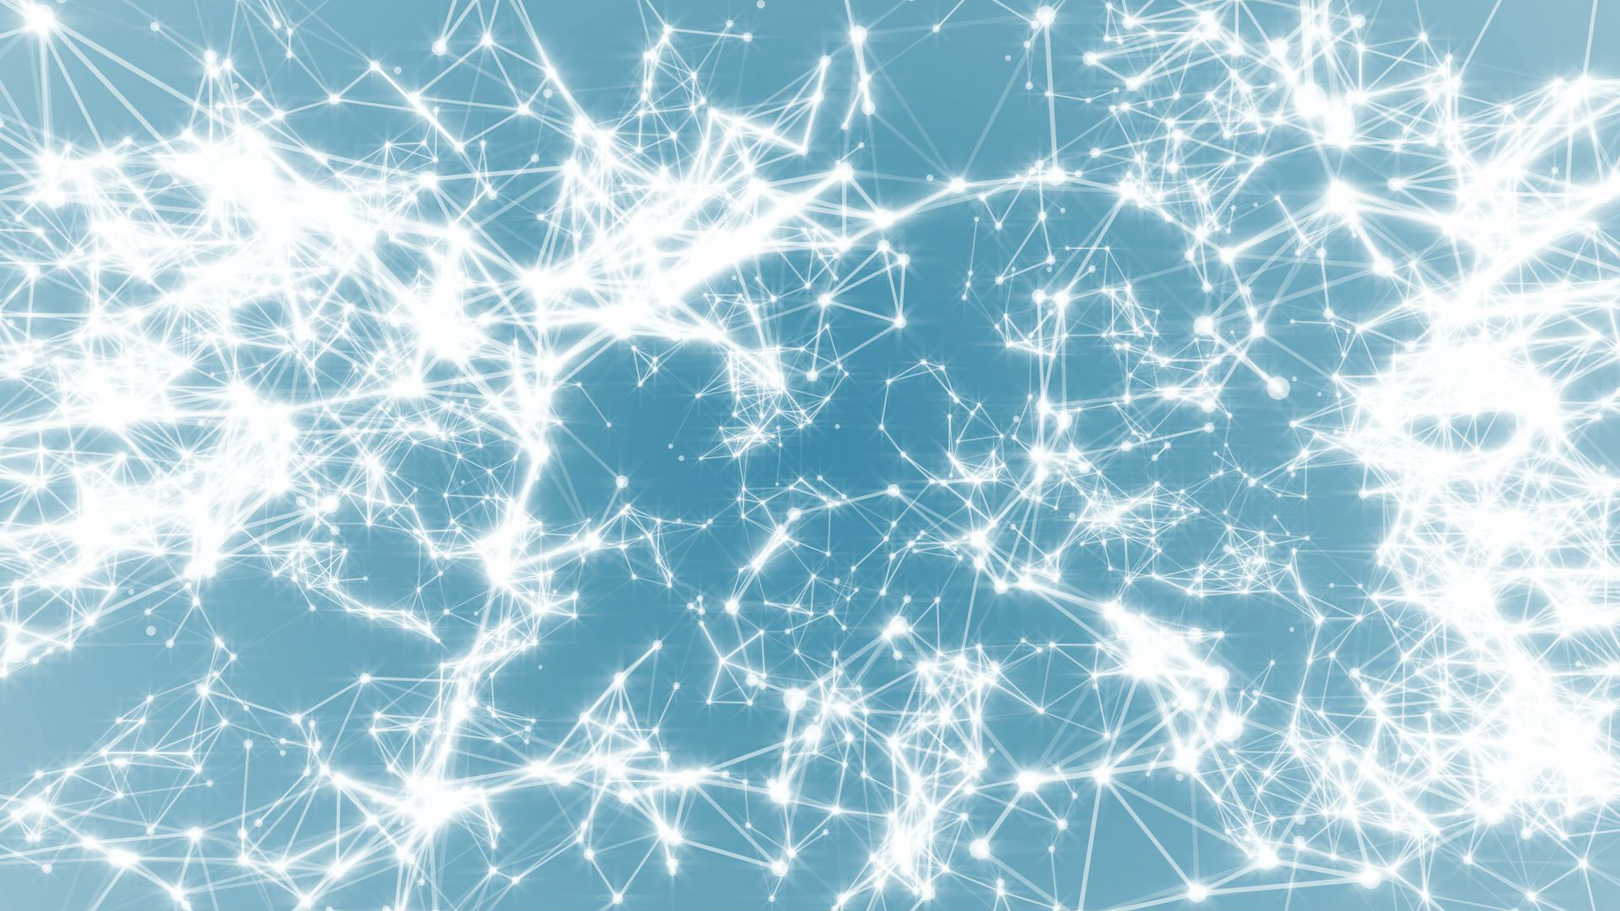
Frontiers of Network Science
Fall 2021
Class 14: Barabasi-Albert Model II
(Chapter 5 in Textbook)
Boleslaw Szymanski
based on slides by
Albert-László Barabási
and Roberta Sinatra
www.BarabasiLab.com

Slide 2
MECHANISMS RESPONSIBLE FOR PREFERENTIAL ATTACHMENT
Copying mechanism
  directed network
    select a node and an edge of this node
    attach to the endpoint of this edge
Walking on a network
  directed network
  the new node connects to a node, then to every
  first, second, … neighbor of this node
Attaching to edges
    select an edge
    attach to both endpoints of this edge
Node duplication
  duplicate a node with all its edges
  randomly prune edges of new node
Network Science: Evolving Network Models
Notes:
Growth is obvius– network with a million nodes could not emerge with a million nodes right away– it had to grow naturally. But it is not obvious at all where does preferential attachment come from.

Slide 3
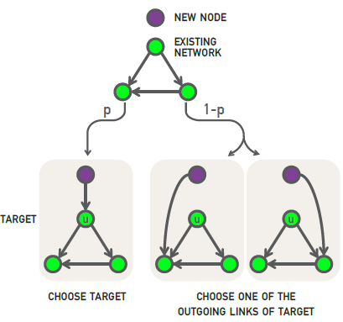
Section 9 Copying model
(a) Random Connection: with probability p the new node links to u.
(b) Copying: with probability p we randomly choose an outgoing link of node u and connect the new node to the selected link's target. Hence the new node “copies” one of the links of an earlier node
(a) the probability of selecting a node is 1/N.
(b) is equivalent with selecting a node linked to a randomly selected link. The probability of selecting a degree-k node through the copying process of step (b) is k/2L for undirected networks.
The likelihood that the new node will connect to a degree-k node follows preferential attachment
Social networks: Copy your friend’s friends.
Citation Networks: Copy references from papers we read.
Protein interaction networks: gene duplication,
Notes:
When building a new webpage, authors tend to borrow links from webpages covering similar topics, a process captured by the copying model [17, 18]. In the model in each time step a new node with a single link is added to the network. To choose the target node we randomly select a node u and follow a two-step procedure:

Slide 4
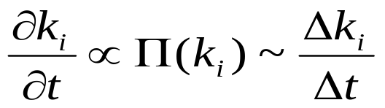
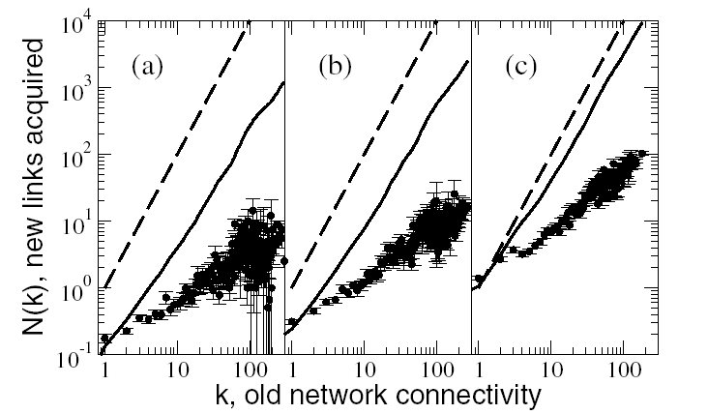
Preferential Attachment!
For given Δt: Δk ∝ Π(k)
k vs. Δk : linear increase in the # of links
S. Cerevisiae PIN: proteins classified into 4 age groups
Eisenberg E, Levanon EY, Phys. Rev. Lett. 2003.

Slide 5



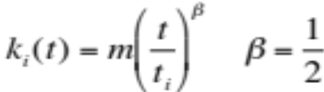

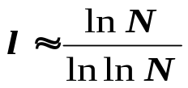

SUMMARY: PROPERTIES OF THE BA MODEL
Nr. of nodes:
Nr. of links:
Average degree:
Degree dynamics
Degree distribution:
Average Path Length:
Clustering Coefficient:
β: dynamical exponent
γ: degree exponent
The network grows, but the degree distribution is stationary.
Network Science: Evolving Network Models

Slide 6
DEGREE EXPONENTS
γ^{collab}
γ^{metab}
γ^{intern}
γ^{synonyms}
γ^{w}_{in}
γ^{w}_{out}
γ^{actor}
γ^{cita}
γ^{sex}
γ=1
γ=2
γ=3
<k²> diverges
<k²> finite
BA model
Can we change the degree exponent?
Network Science: Evolving Network Models

Slide 7
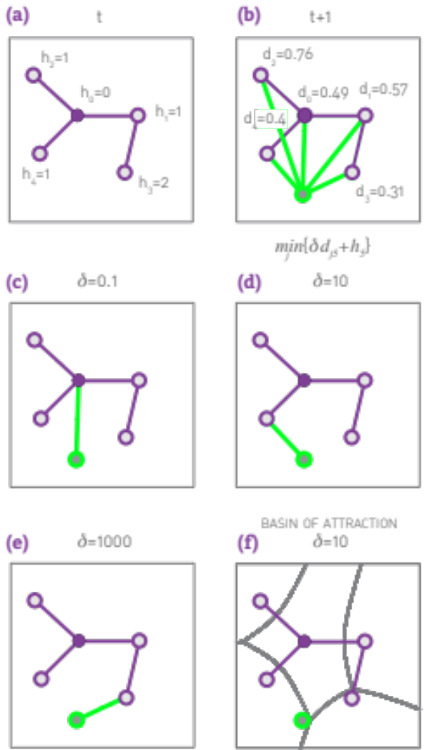
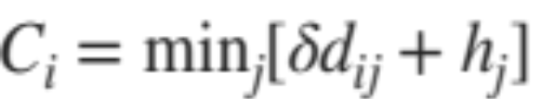
Section 9 Optimization model for connecting new router
h_{j} denotes the distance of node j to the central node h₀
d_{jj} denotes the bandwidth between nodes i, j
δ denotes the ratio of cost of cable to delay
Question: where to place a new router ?
Notes:
A longstanding assumption of economics is that humans make rational decisions, balancing cost against benefits. In other words, each individual aims to maximize its personal advantage. This is the starting point of rational choice theory in economics [21] and it is a hypothesis central to modern political science, sociology and philosophy. As we show below, such rational decisions can lead to preferential attachment [22, 23, 24].
Consider the Internet, whose nodes are routers connected via cables. Establishing a new Internet connection between two routers requires us to lay down a new cable between them. As this is costly, each new link is preceded by a careful cost-benefit analysis. Each new router (node) will choose its link to balance access to good network performance (i.e. proper bandwith) with the cost of laying down a new cable (i.e. physical distance). This can be a conflicting desire, as the closest node may not offer the best network performance.

Slide 8
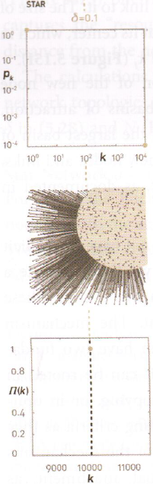
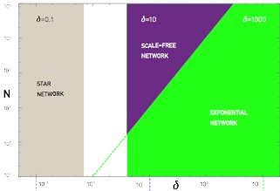
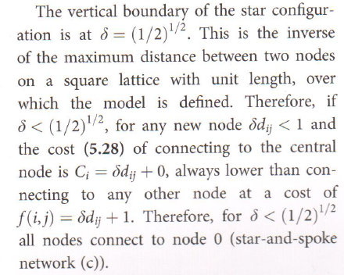
Section 9 Optimization model
Star Network

Slide 9
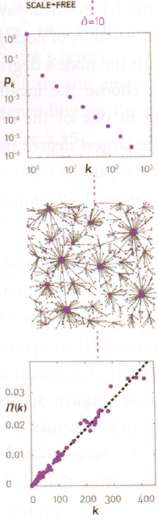
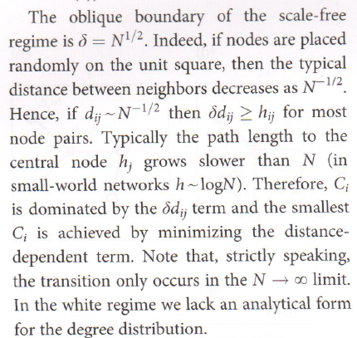
Section 9 Optimization model
Scale-Free Network

Slide 10
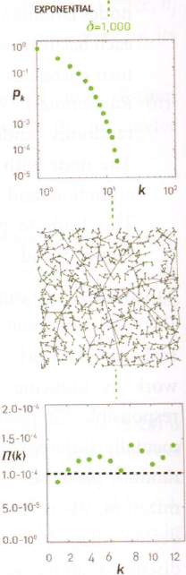
Section 9 Optimization model
Exponential Networks

Slide 11
Section 10
Diameter and clustering coefficient

Slide 12
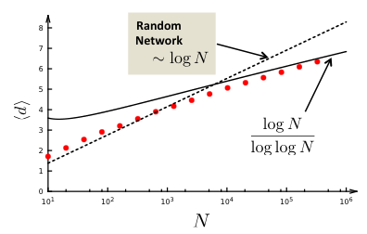
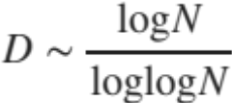
Section 10 Diameter
Bollobas, Riordan, 2002

Slide 13
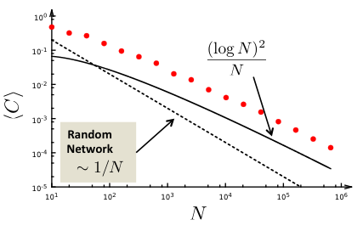
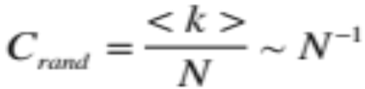
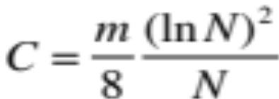
Section 10 Clustering coefficient
Reminder: for a random graph we have:
What is the functional form of C(N)?
Konstantin Klemm, Victor M. Eguiluz,
Growing scale-free networks with small-world behavior,
Phys. Rev. E 65, 057102 (2002), cond-mat/0107607

Slide 14
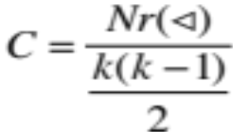
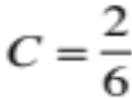
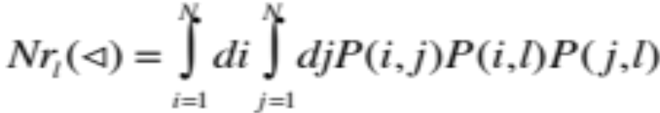
CLUSTERING COEFFICIENT OF THE BA MODEL
Nr(Δ)
1
2
Denote the probability to have a link between node i and j with P(i,j)
The probability that three nodes i,j,l form a triangle is P(i,j)P(i,l)P(j,l)
The expected number of triangles in which a node l with degree k_{l} participates is thus:
(Δ)
We need to calculate P(i,j).
Network Science: Evolving Network Models

Slide 15
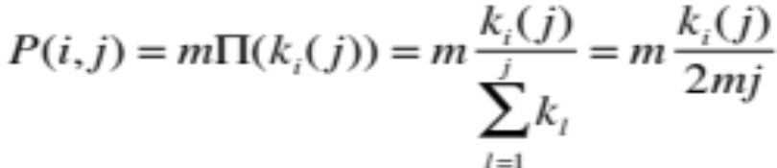
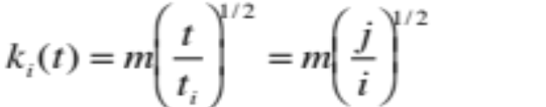
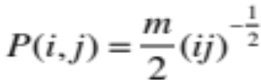
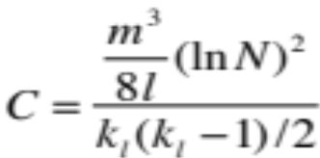
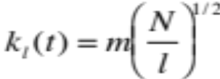


CLUSTERING COEFFICIENT OF THE BA MODEL
Calculate P(i,j).
Node j arrives at time t_{j}=j and the probability that it will link to node i with degree k_{i} already in the network is determined by preferential attachment:
Where we used that the arrival time of node j is t_{j}=j and the arrival time of node is t_{i}=i
(Δ) =
Which is the degree of node l at current time, at time t=N
Let us approximate:
There is a factor of two difference... Where does it come from?
Network Science: Evolving Network Models

Slide 16
Evolving network models
Network Science: Evolving Network Models

Slide 17


EVOLVING NETWORK MODELS
The BA model is only a minimal model.
Makes the simplest assumptions:
linear growth
linear preferential attachment
Does not capture
variations in the shape of the degree distribution
variations in the degree exponent
the size-independent clustering coefficient
Hypothesis:
The BA model can be adapted to describe most features of real networks.
We need to incorporate mechanisms that are known to take place in real networks: addition of links without new nodes, link rewiring, link removal; node removal, constraints or optimization
Network Science: Evolving Network Models

Slide 18
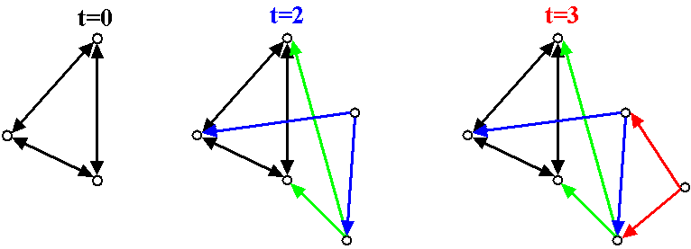
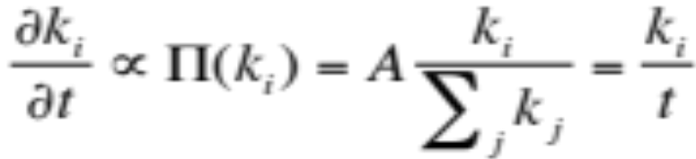


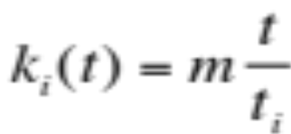
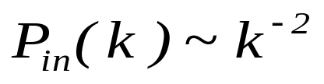
(the simplest way to change the degree exponent)
BA ALGORITHM WITH DIRECTED EDGES
Undirected BA network:
Directed BA network:
β=1: dynamical exponent
γ_{in}=2: degree exponent; P(k_{out})=δ(k_{out}-m)
Undirected BA: β=1/2; γ=3
Network Science: Evolving Network Models

Slide 19
EXTENDED MODEL: Other ways to change the exponent
Extended Model
prob. p : internal links
prob. q : link deletion
prob. 1-p-q : add node
P(k) ~ (k+κ(p,q,m))^{-γ(p,q,m)}
γ ∈ [1,∞)
Network Science: Evolving Network Models
Notes:
It also

Slide 20
EXTENDED MODEL: Small-k cutoff
P(k) ~ (k+κ(p,q,m))^{-γ(p,q,m)} γ ∈ [1,∞)
Extended Model
prob. p : internal links
prob. q : link deletion
prob. 1-p-q : add node
→Predicts a small-k cutoff
a correct model should predict all aspects of the degree distribution, not only the degree exponent.
Degree exponent is a continuous function of p,q, m
p=0.937
m=1
κ = 31.68
γ = 3.07
Actor network
Network Science: Evolving Network Models
Notes:
It also

Slide 21
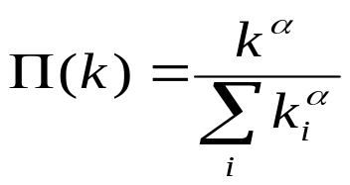
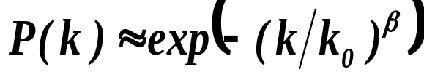
NONLINEAR PREFERENTIAL ATTACHMENT: MORE MODELS
Non-linear preferential attachment:
→ P(k) does not follow a power law for α≠1
⇒ α<1 : stretch-exponential
⇒ α>1 : no-scaling (α>2 : “gelation”)
P. Krapivsky, S. Redner, F. Leyvraz, Phys. Rev. Lett. 85, 4629 (2000)
Network Science: Evolving Network Models

Slide 22

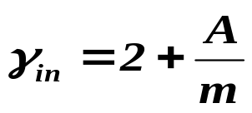
INITIAL ATTRACTIVENESS
BA model: k=0 nodes cannot aquire links, as Π(k=0)=0
(the probability that a new node will attach to it is zero)
A - initial attractiveness
Initial attractiveness shifts the degree exponent:
Note: the parameter A can be measured from real data, being the rate at which k=0 nodes acquire links, i.e. Π(k=0)=A
Dorogovtsev, Mendes, Samukhin, Phys. Rev. Lett. 85, 4633 (2000)
Network Science: Evolving Network Models

Slide 23
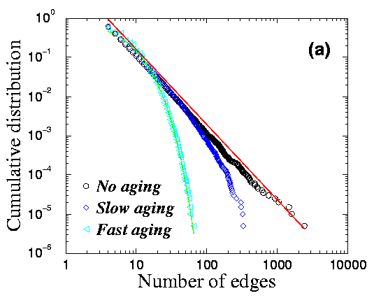


GROWTH CONSTRAINTS AND AGING CAUSE CUTOFFS
Finite lifetime to acquire new edges
L. A. N. Amaral et al., PNAS 97, 11149 (2000)
Gradual aging:
S. N. Dorogovtsev and J. F. F. Mendes, Phys. Rev. E 62, 1842 (2000)
Network Science: Evolving Network Models

Slide 24
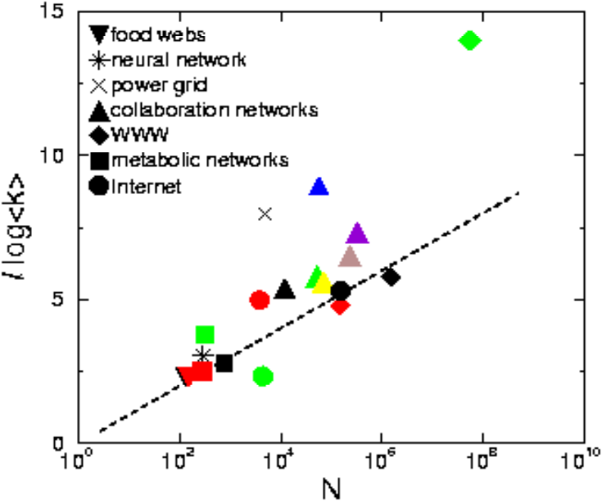
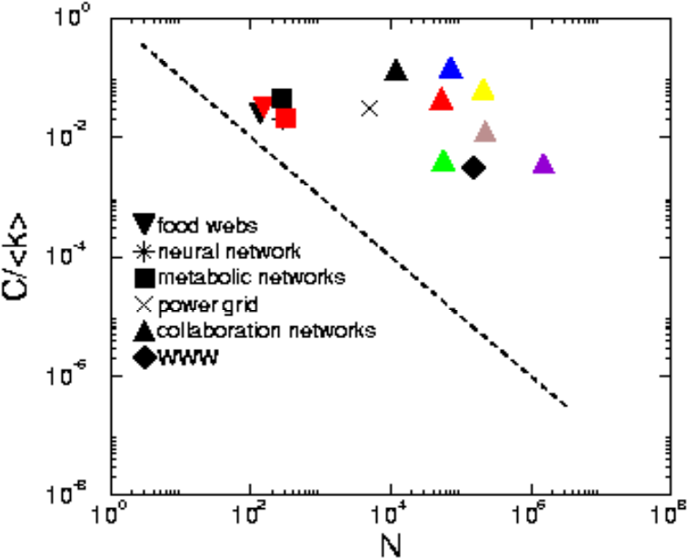








THE LAST PROBLEM: HIGH, SYSTEM-SIZE INDEPENDENT C(N)
Pathlenght
Clustering
Degree Distr.
P(k) ~ k^{-γ}
Regular network
P(k)=δ(k-k_{d})
Erdos-
Renyi
Watts-
Strogatz
Exponential
Barabasi-Albert
P(k) ~ k^{-γ}
Network Science: Evolving Network Models
Notes:
As we can see, the BA model gets approximatelly right the small world effect, the degree distribution. When it comes to the clustering coefficient, the bad news is that it still decreases with the system size. The good news, is that it decreases slower that the ER prediction. Most important, however, the real difference is this: the model is really a modeling platform, that can be adjusted to the properties of real networks– we will see that in fact it can generate a finite, system size independnet clustering coefficient, if our main goal is to do just that.

Slide 25

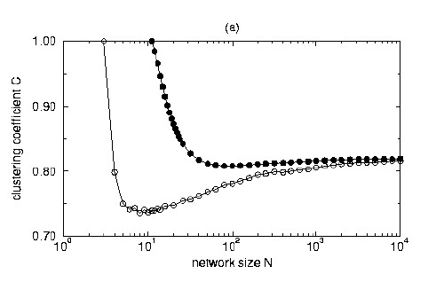




A MODEL WITH HIGH CLUSTERING COEFFICIENT
Each node of the network can be either active or inactive.
There are m active nodes in the network in any moment.
Start with m active, completely connected nodes.
Each timestep add a new node (active) that connects to m active nodes.
Deactivate one active node with probability:
C→ C* when N→∞
K. Klemm and V. Eguiluz, Phys. Rev. E 65, 036123 (2002)
Network Science: Evolving Network Models

Slide 26
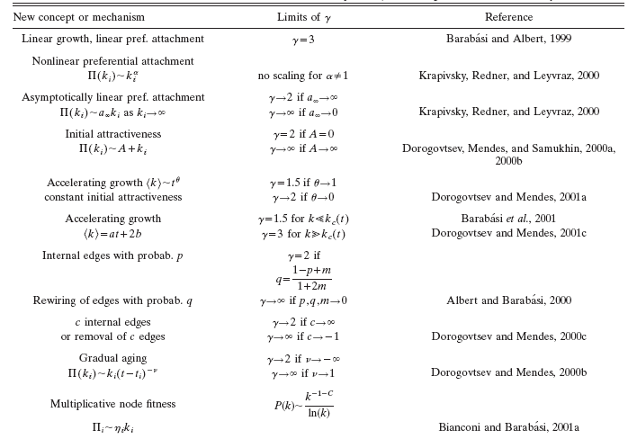
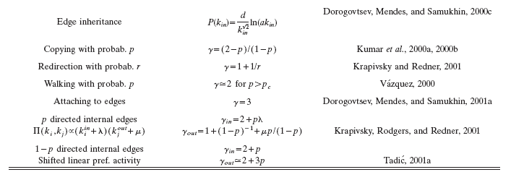

Slide 27
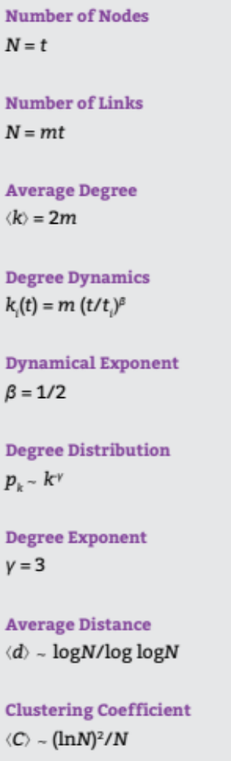
Section 11: Summary
The network grows, but the degree distribution is stationary.

Slide 28
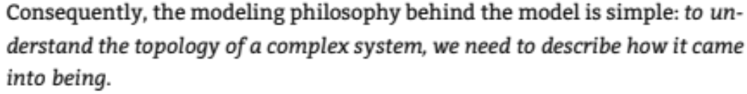
Section 11: Summary
The network grows, but the degree distribution is stationary.

Slide 29
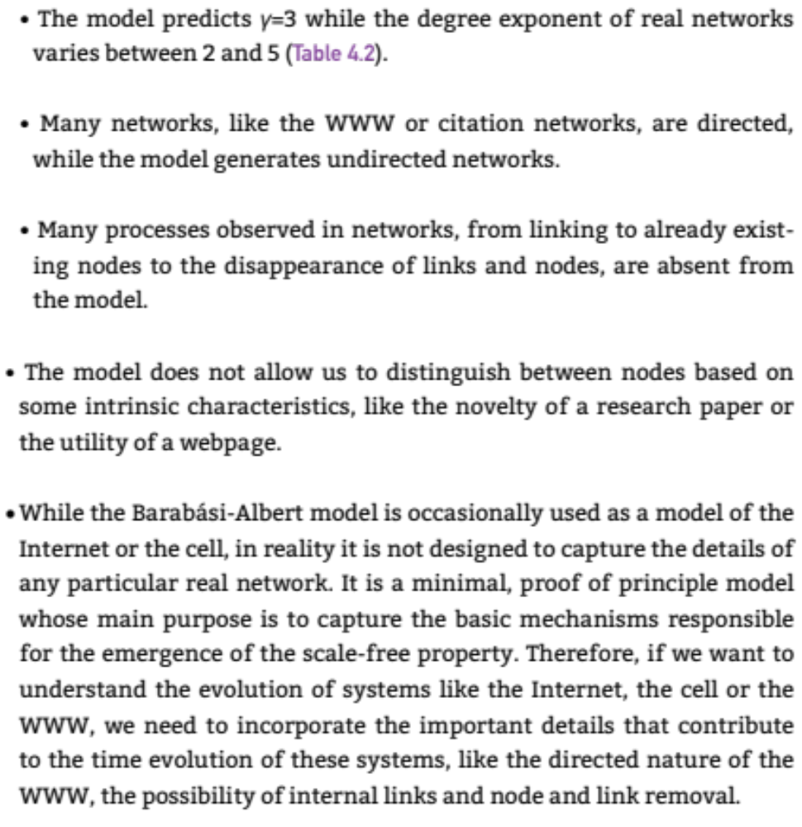
Section 11: Summary

Slide 30
LESSONS LEARNED: evolving network models
There is no universal exponent characterizing all networks.
Growth and preferential attachment are responsible for the emergence of the scale-free property.
The origins of the preferential attachment is system-dependent.
Modeling real networks:
      identify the microscopic processes that take place in the system
      measure their frequency from real data
      develop dynamical models that capture these
      processes.
5. If the model is correct, it should correctly predict not only the degree exponent, but both small and large k-cutoffs.
Network Science: Evolving Network Models

Slide 31
LESSONS LEARNED: evolving network models
Philosophical change in network modeling:
ER, WS models are static models – the role of the network modeler it to cleverly place the links between a fixed number of nodes to that the network topology mimic the networks seen in real systems.
BA and evolving network models are dynamical models: they aim to reproduce how the network was built and evolved.
Thus their goal is to capture the network dynamics, not the structure.
→ as a byproduct, you get the topology correctly
Network Science: Evolving Network Models

Slide 32
LESSONS LEARNED: evolving network models
Philosophical change in network modeling:
ER, WS models are static models – the role of the network modeler it to cleverly place the links between a fixed number of nodes to that the network topology mimic the networks seen in real systems.
BA and evolving network models are dynamical models: they aim to reproduce how the network was built and evolved.
Thus their goal is to capture the network dynamics, not the structure.
→ as a byproduct, you get the topology correctly
Network Science: Evolving Network Models

Slide 33
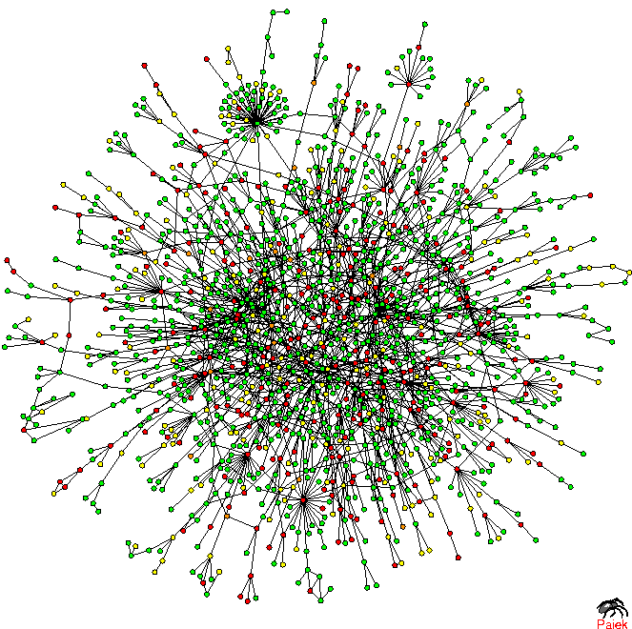



TOPOLOGY OF THE PROTEIN NETWORK
Nodes: proteins
Links: physical interactions (binding)
Puzzling pattern:
Hubs tend to link to small degree nodes.
Why is this puzzling?
In a random network, the probability that a node with degree k links to a node with degree k’ is:
k≅50, k’=13, N=1,458, L=1746
Yet, we see many links between degree 2 and 1 links, and no links between the hubs.
H. Jeong, S.P. Mason, A.-L. Barabasi, Z.N. Oltvai, Nature 411, 41-42 (2001)
Network Science: Degree Correlations

